Slide 1
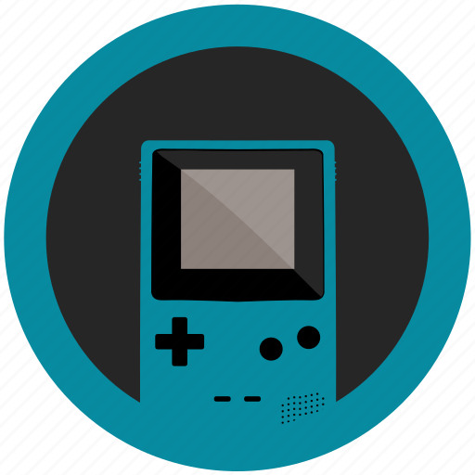


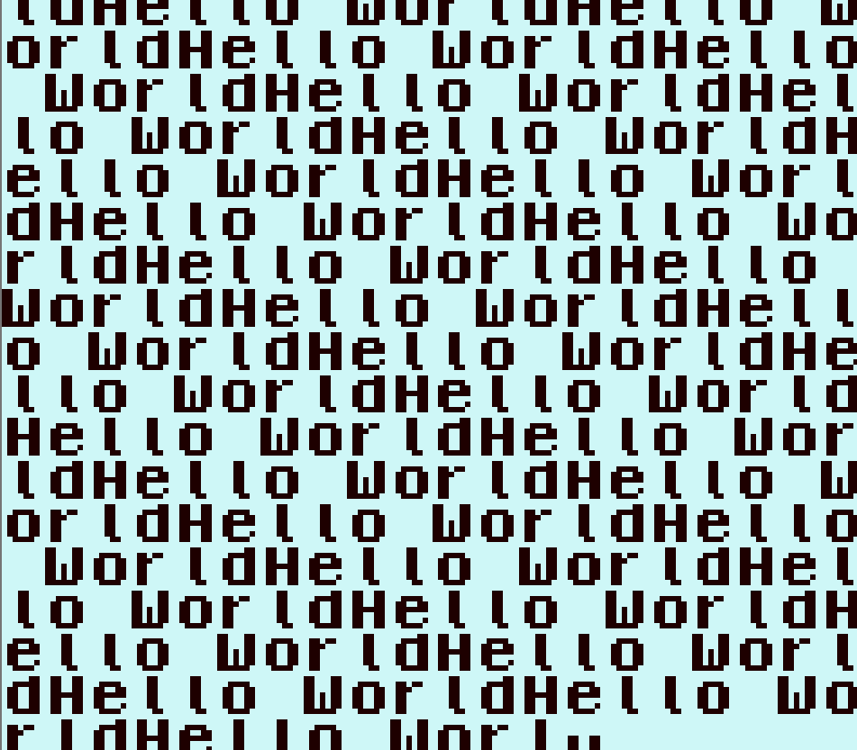
User Interface
Emulator
Database
Emulator State
Amplify: Nintendo Game Boy Emulator

